Slide 1
1ST APRIL 2024-25
SESSION BEGAN

Slide 2
SPORTS
2024-25

Slide 3
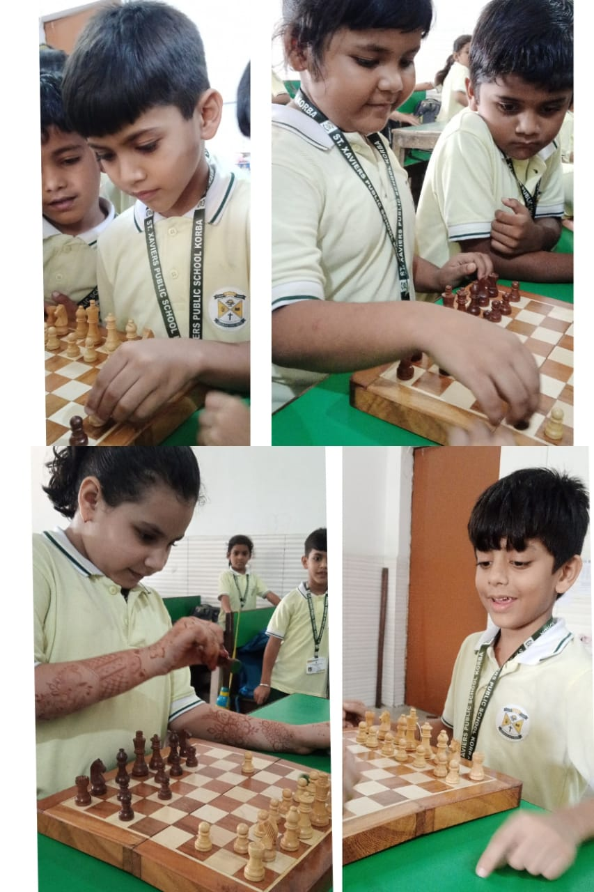
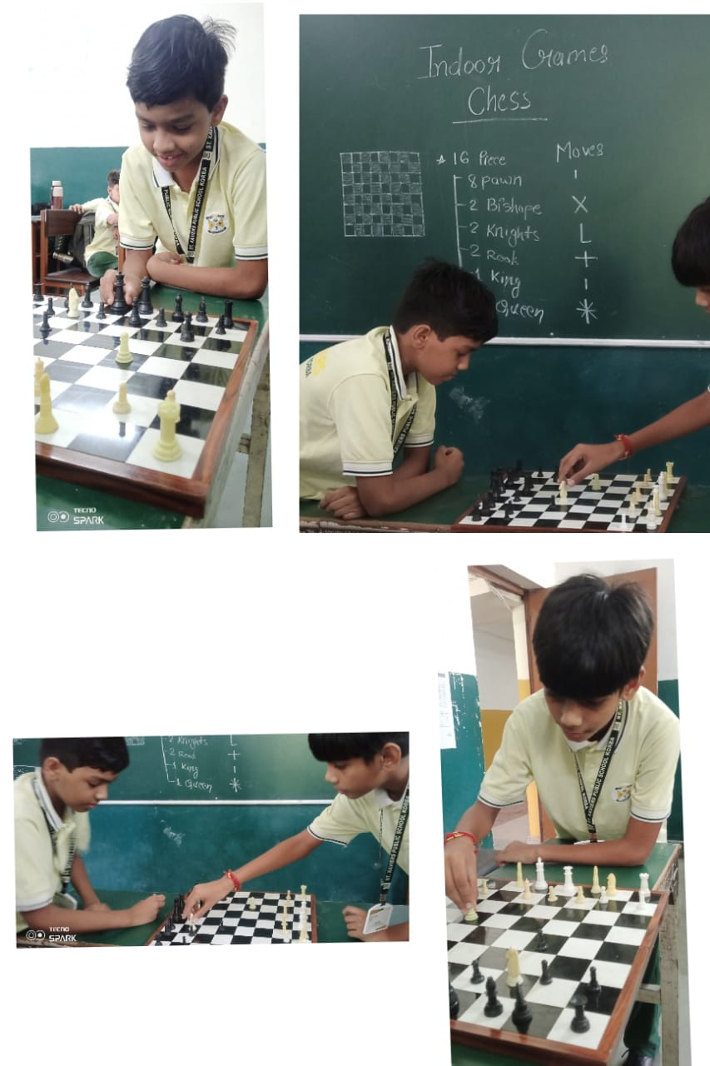
INDOOR GAMES 13.04.2024
SPORTS

Slide 4
sports

Slide 5
SPORTS ACHIEVEMENTs

Slide 6
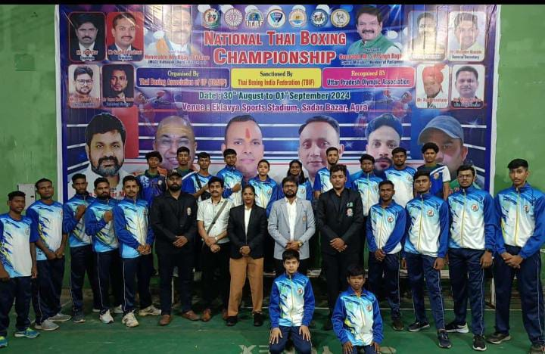
National Thai boxing championship National level
1. Anuj Agrawal XII C

Slide 7
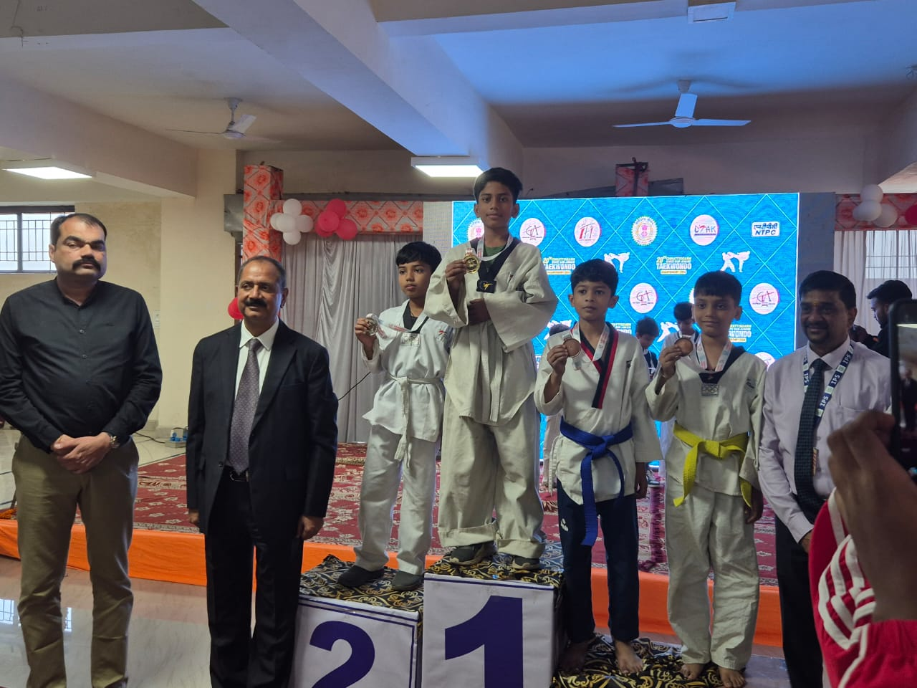
National Thai boxing championshipNational level
1. Anuj Agrawal XII C

Slide 8
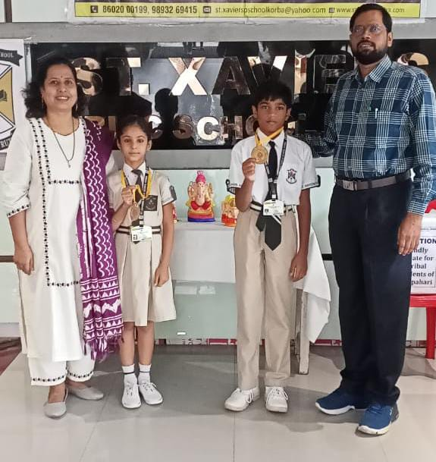
State level Kudo championship Durg
1. Jasmit kour IV
B
2. K. Rishit VI B

Slide 9
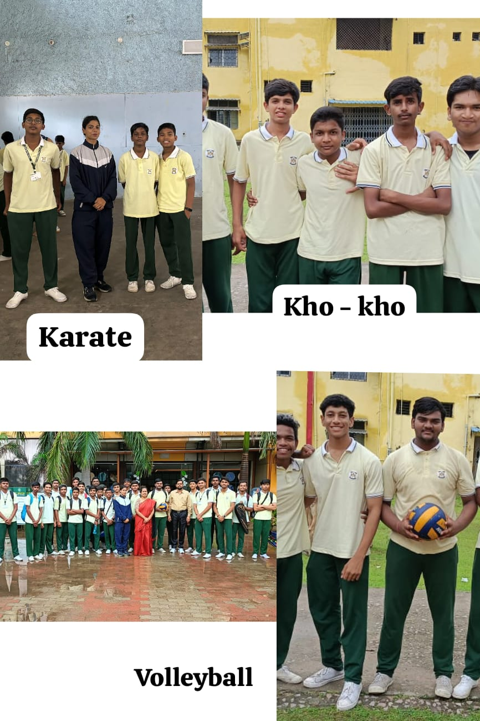
Regional level players
Volleyball – Rajiv Sahu

Slide 10
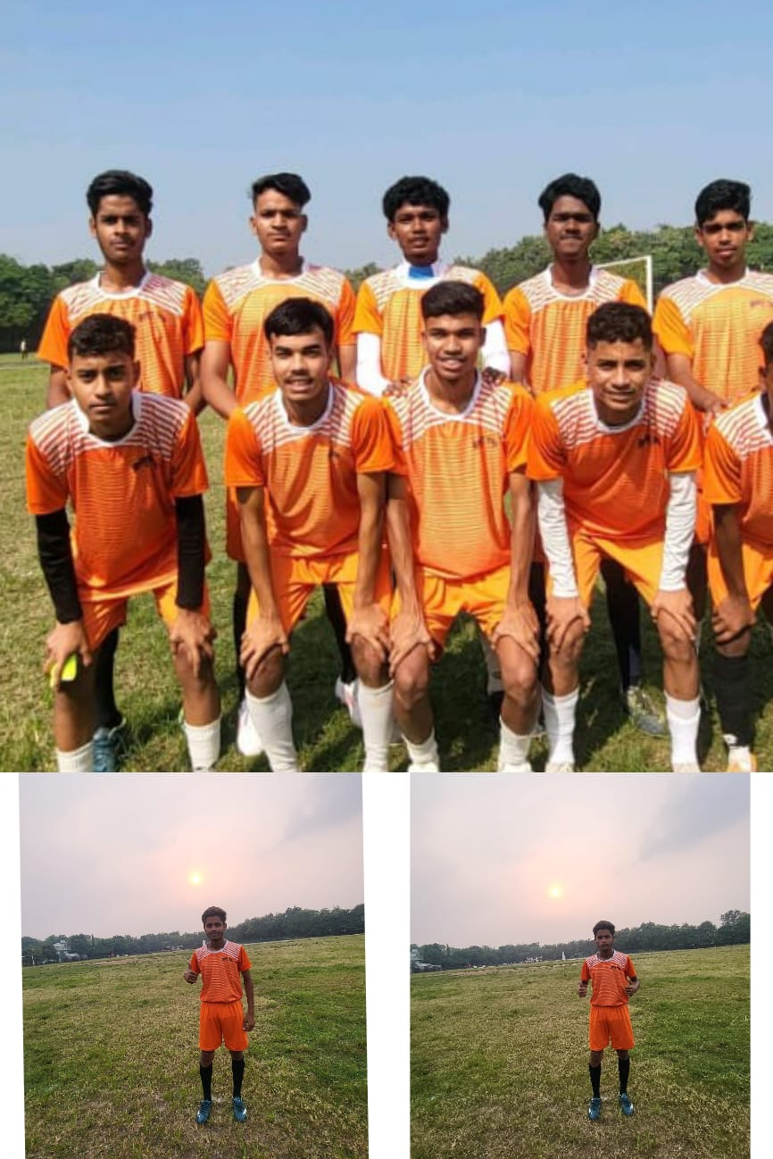
School games federation of India
State Level Football
Ashish Dubey XI C

Slide 11
SPORTS ACHIEVEMENTS
Name - Anuj Agarwal XII C Won- Gold 🏅medal in National Thai Boxing Championship

Slide 12
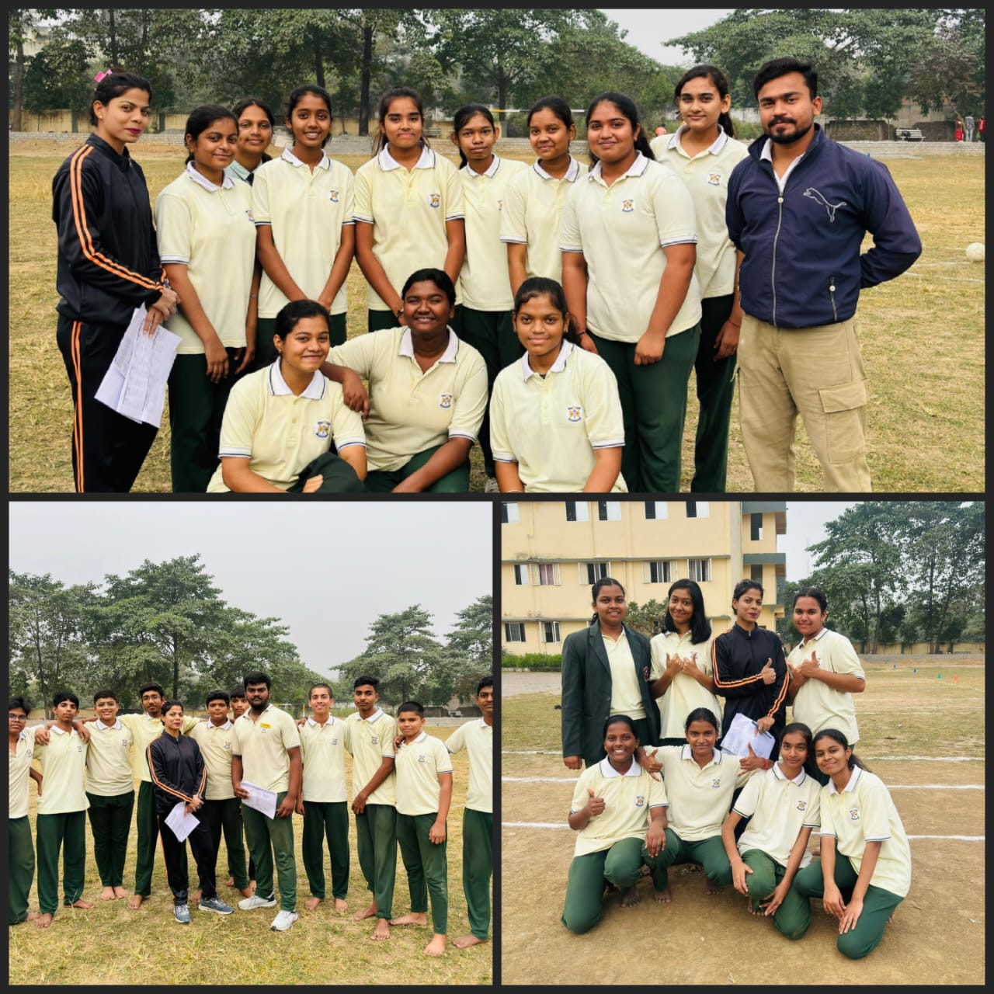
Annual sports 18.12.2024

Slide 13
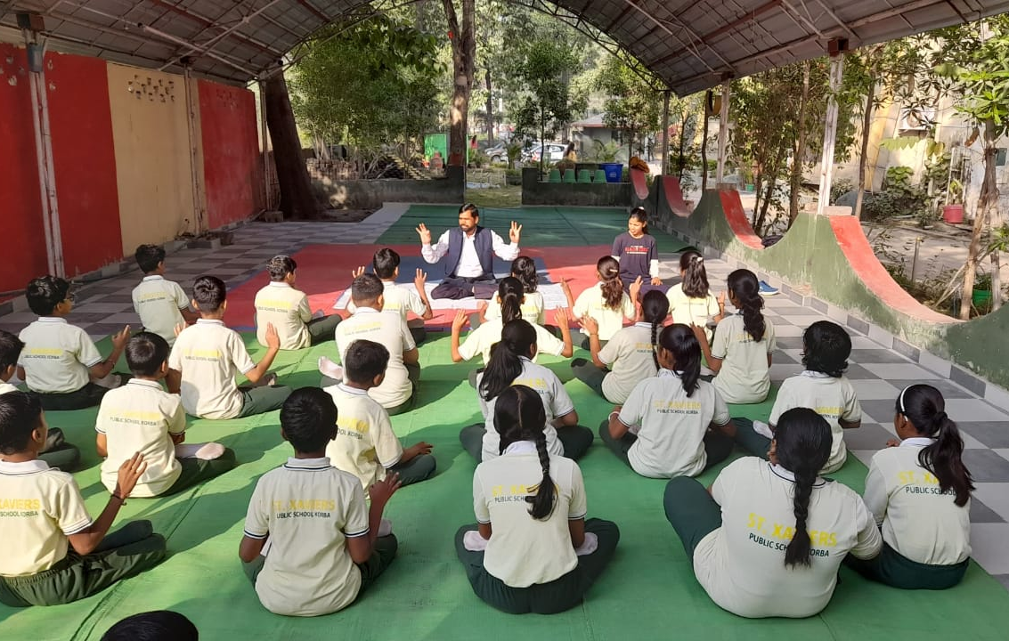
YOGA DAY 21.06.2024

Slide 14
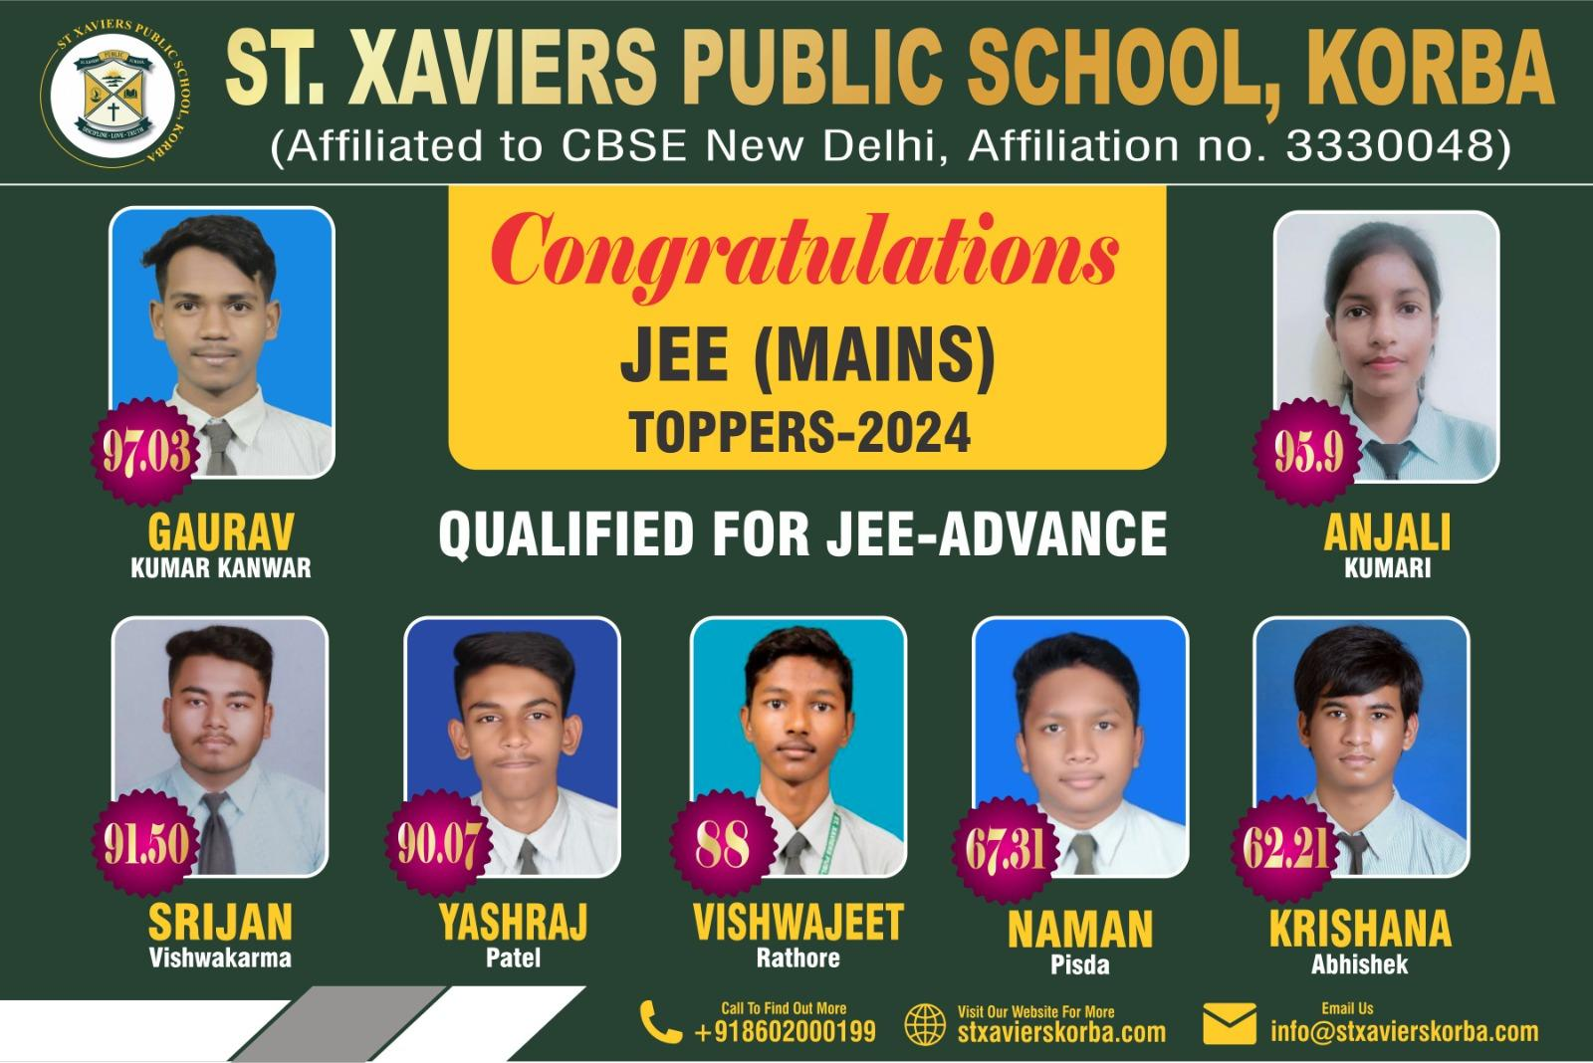
COMPETITIVE EXAMS 2024
JEE MAINS
TOPPERS
● Gaurav Kumar Kanwar- 97.03.
● Anjali Kumari - 95.9
● Srijan Vishwakarma- 91.50
● Yashraj Patel - 90.07
● Vishwajeet Rathore – 88

Slide 15
Neet toppers 2024-25
Aryan Sahu – 642/720
● Anjali Kumari- 634/720
● Garima Agrawal – 631/720
● Mayank Singh – 606/720
● Saurabh Dadsena – 453/720
● Oshika Sonwani – 305/720

Slide 16
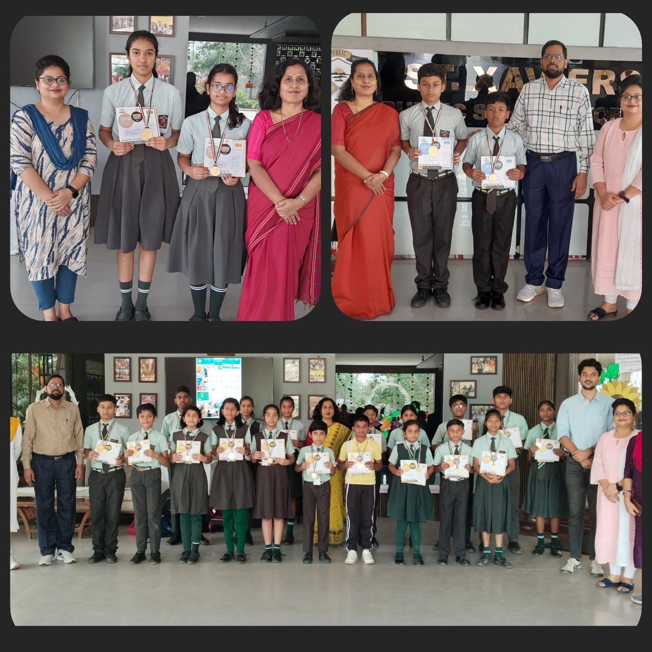
OLYMPIAD EXAMINATION

Slide 17
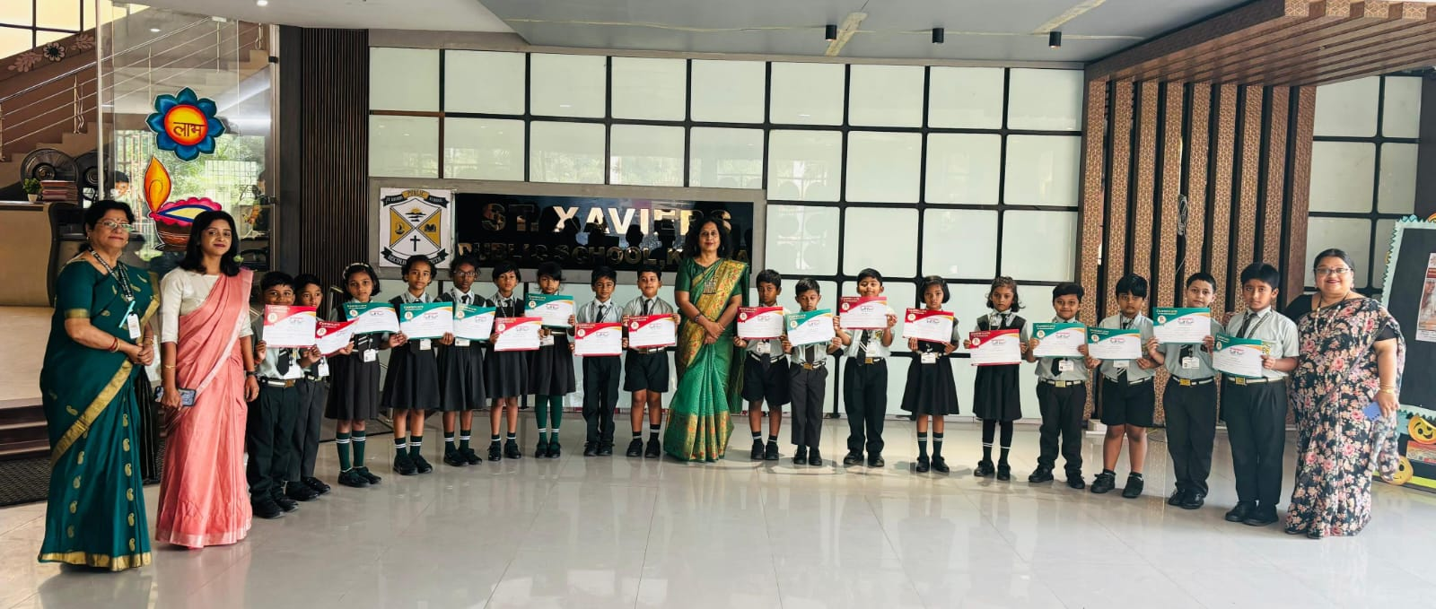
SPELL BEE Date- 11.11.2024 (Monday)

Slide 18
COMPETITIONS
CCA

Slide 19
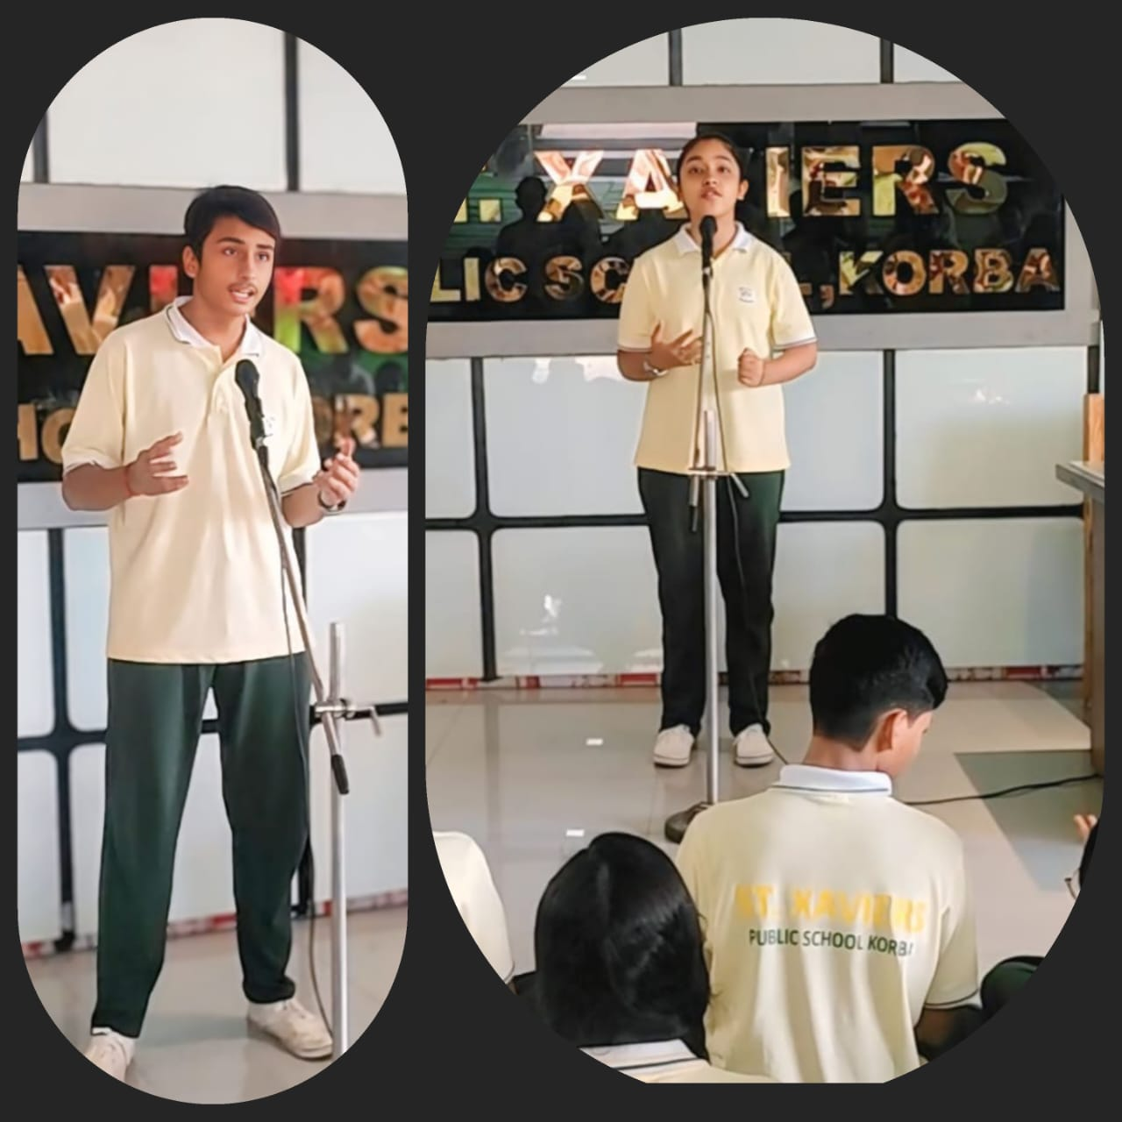
EXTEMPORE (ENGLISH)

Slide 20
Photography competition

Slide 21
ART & CRAFT
Richa Raj XC (Group -B)Secured the Consolation Prize (7500/-) in State Level Painting Competition, conducted by Power Grid Corporation Durg .Date-27/11/2024

Slide 22
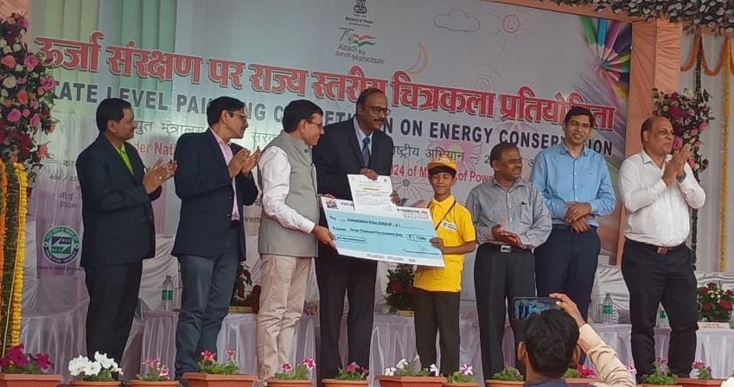
Rohit Maity VIC (Group -A)Secured the Consolation Prize (7500/-) in State Level Painting Competition, conducted by Power Grid corporation Durg .Date - 27/11/2024

Slide 23
DANCE
NATIONAL LEVEL DANCE COMPETITIONDurg Bhilai Chhattisgarh (13/10/24 )Junior category in solo semi classical dance 🥈 Position-manvi ratre (class 7th C)💐

Slide 24
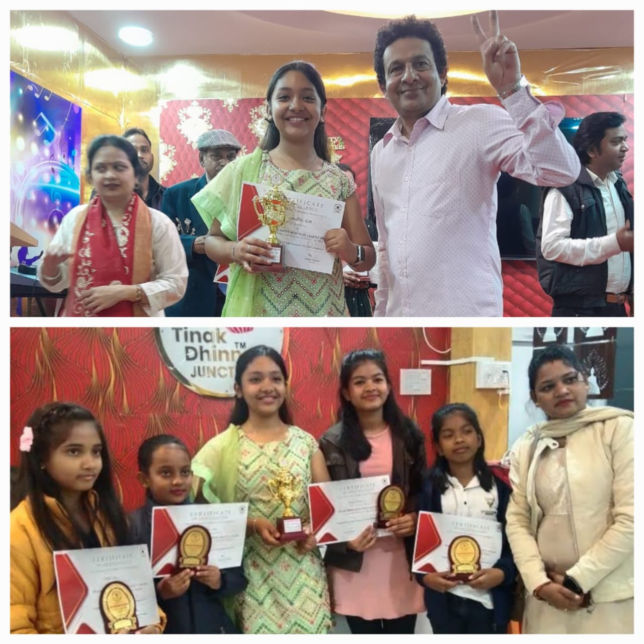
MUSIC
Tink dhin junction music academy Conduct karaoke singing competition Date -Position- St.Xaviers public school students 1st- Sai swastika rath 10th A2nd- Divya Vaishnav 9A3rd-aditi sahu 6A4th- Syantika das5th-aditya bhoi

Slide 25
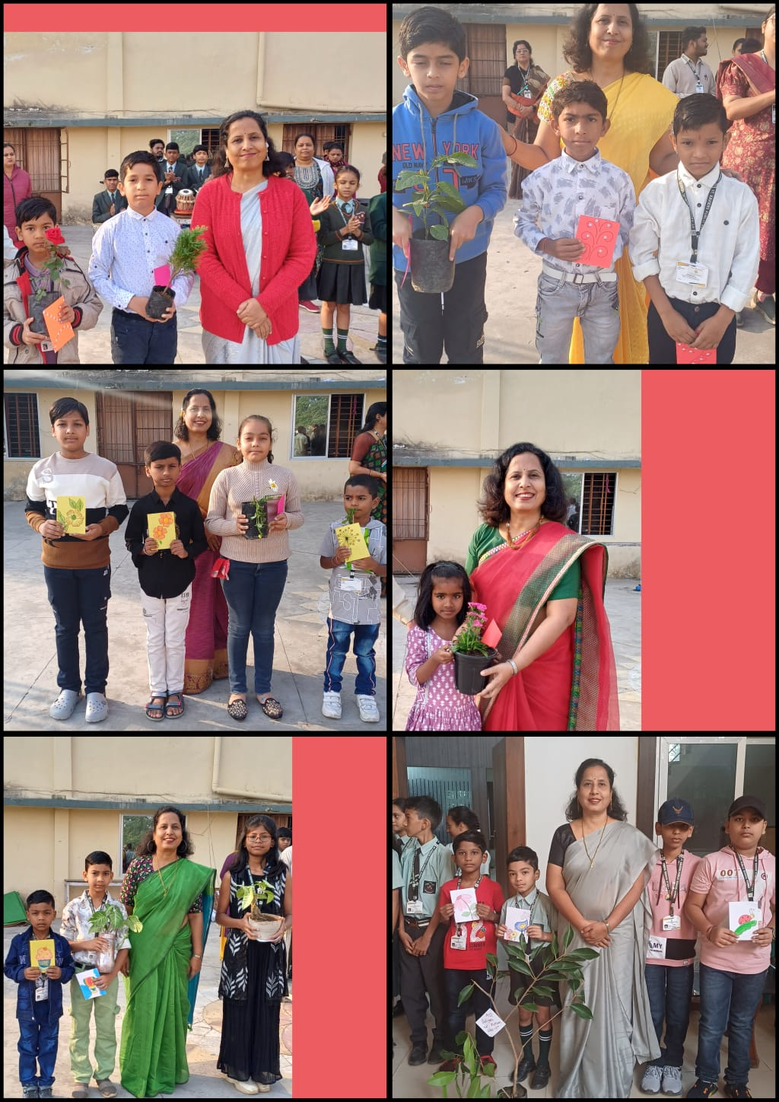
Morning assembly

Slide 27
NATIONAL HERITAGE & TRADITIONS

Slide 28
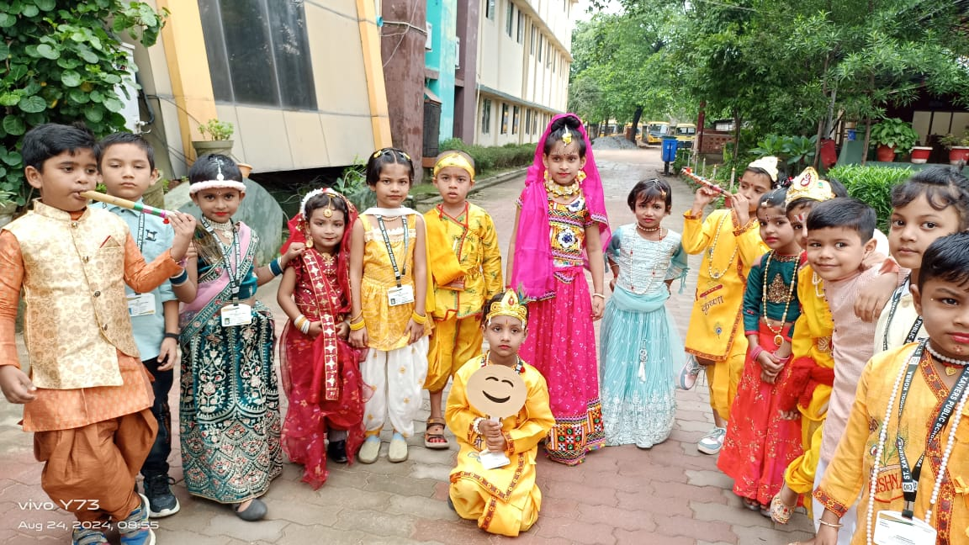
Krishna janmashtami

Slide 29
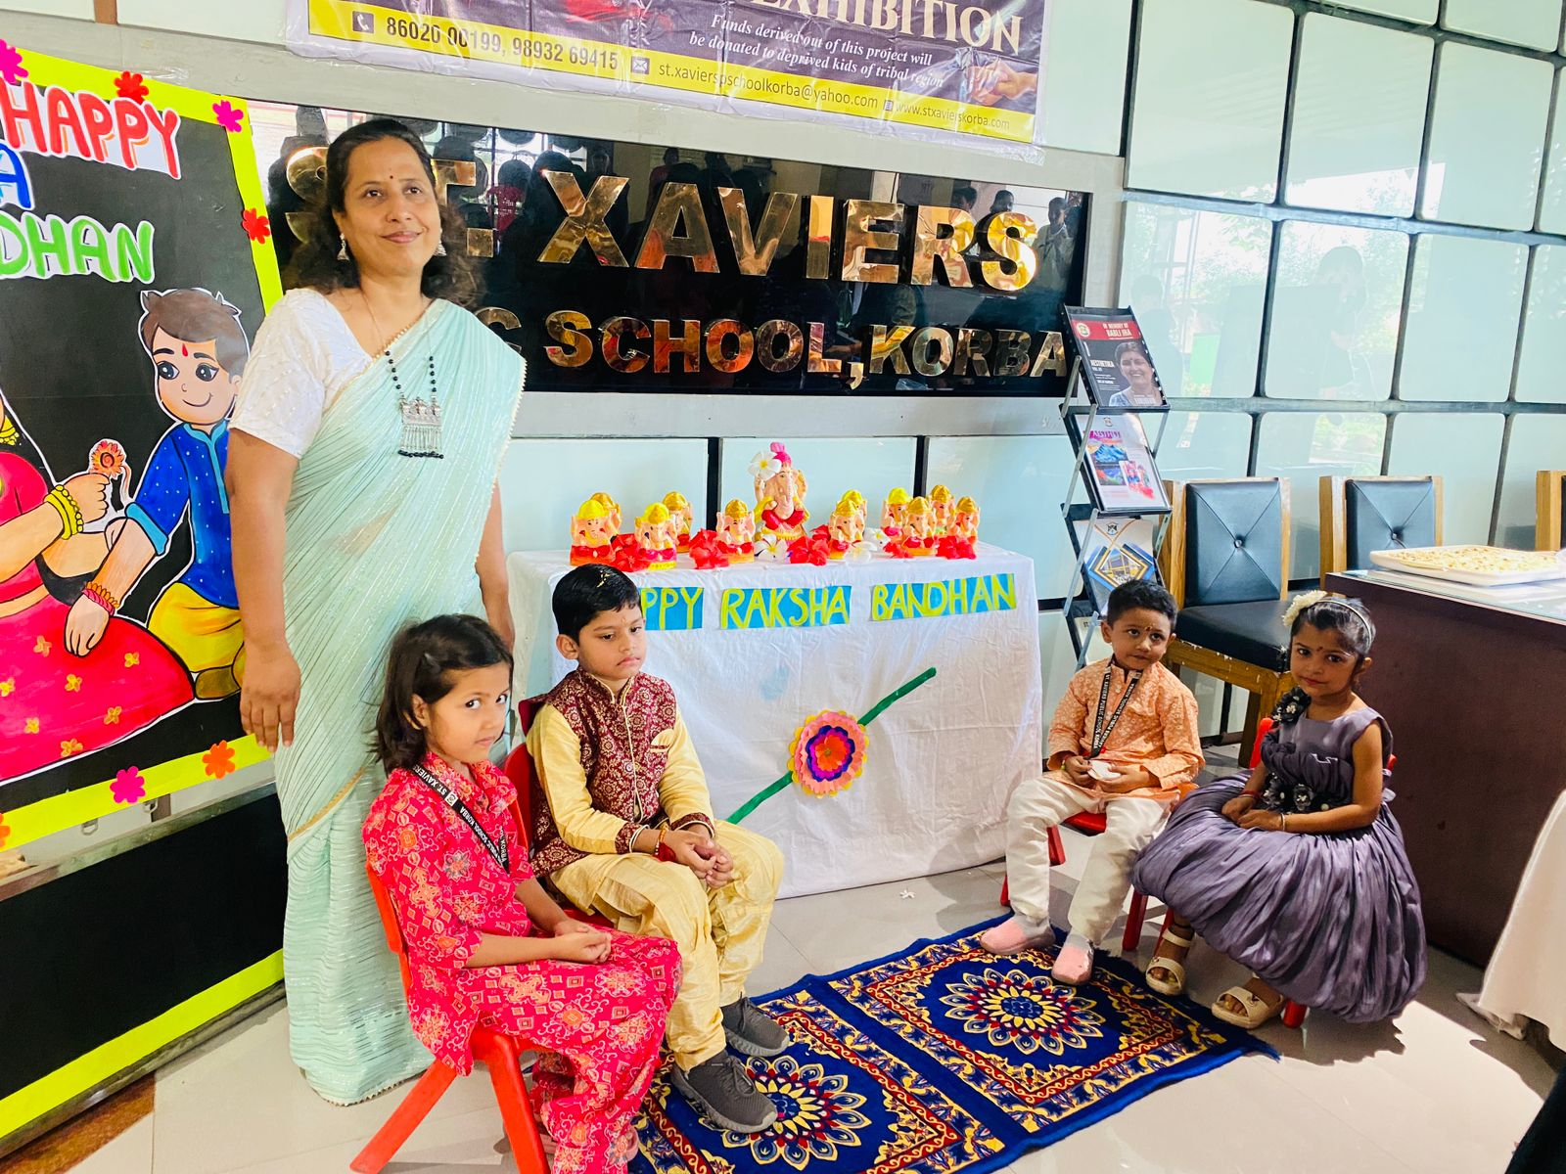
Raksha bandhan

Slide 30
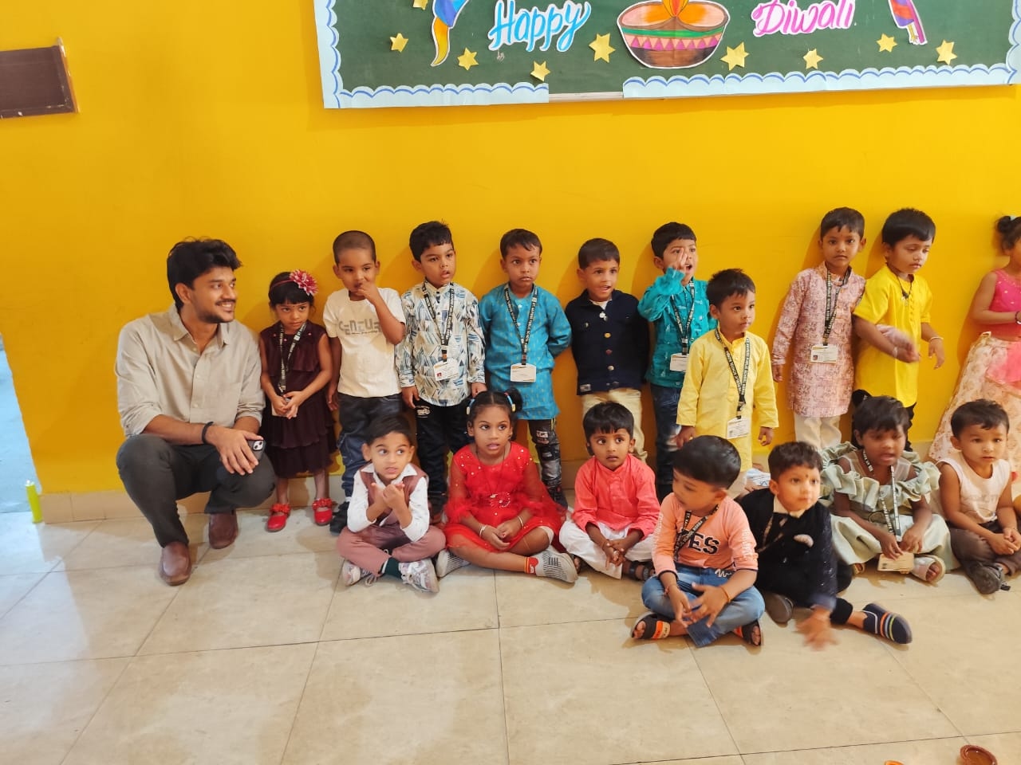
Diwali celebration

Slide 31
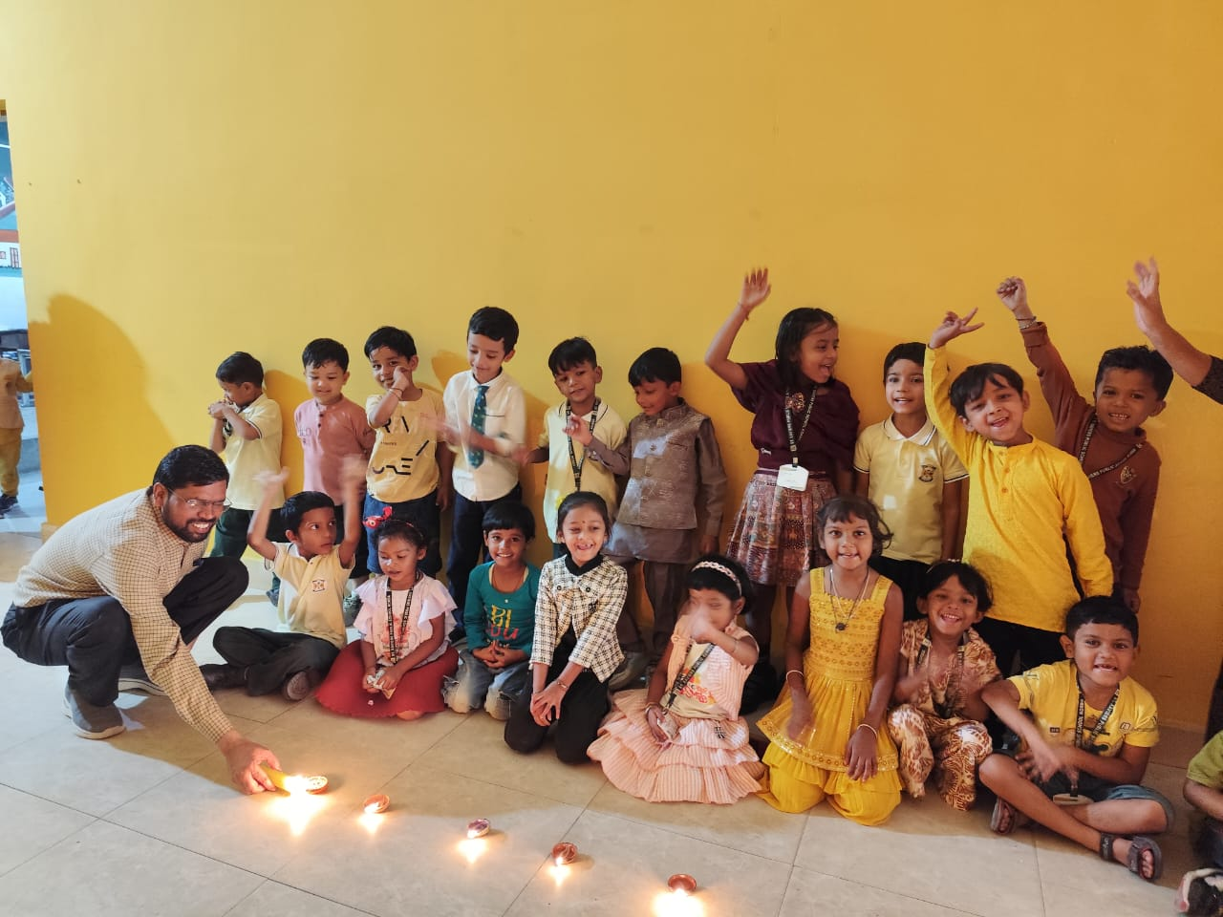

Slide 32
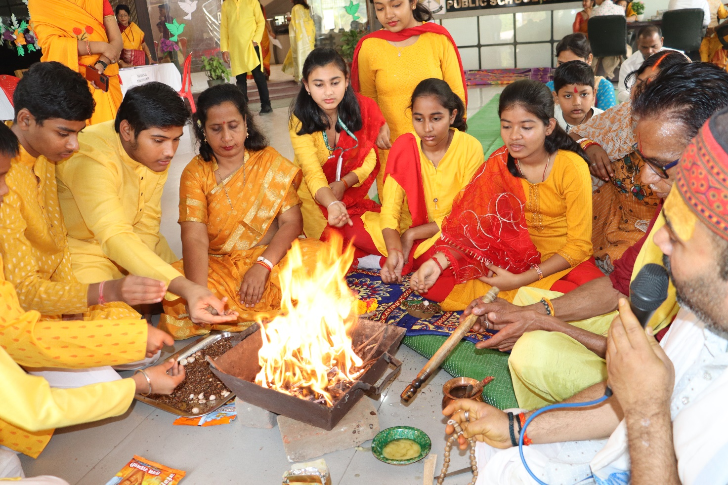
akshar abhyasam 14.02.2024

Slide 33
PROJECTs OF SOCIAL WELFARE

Slide 34
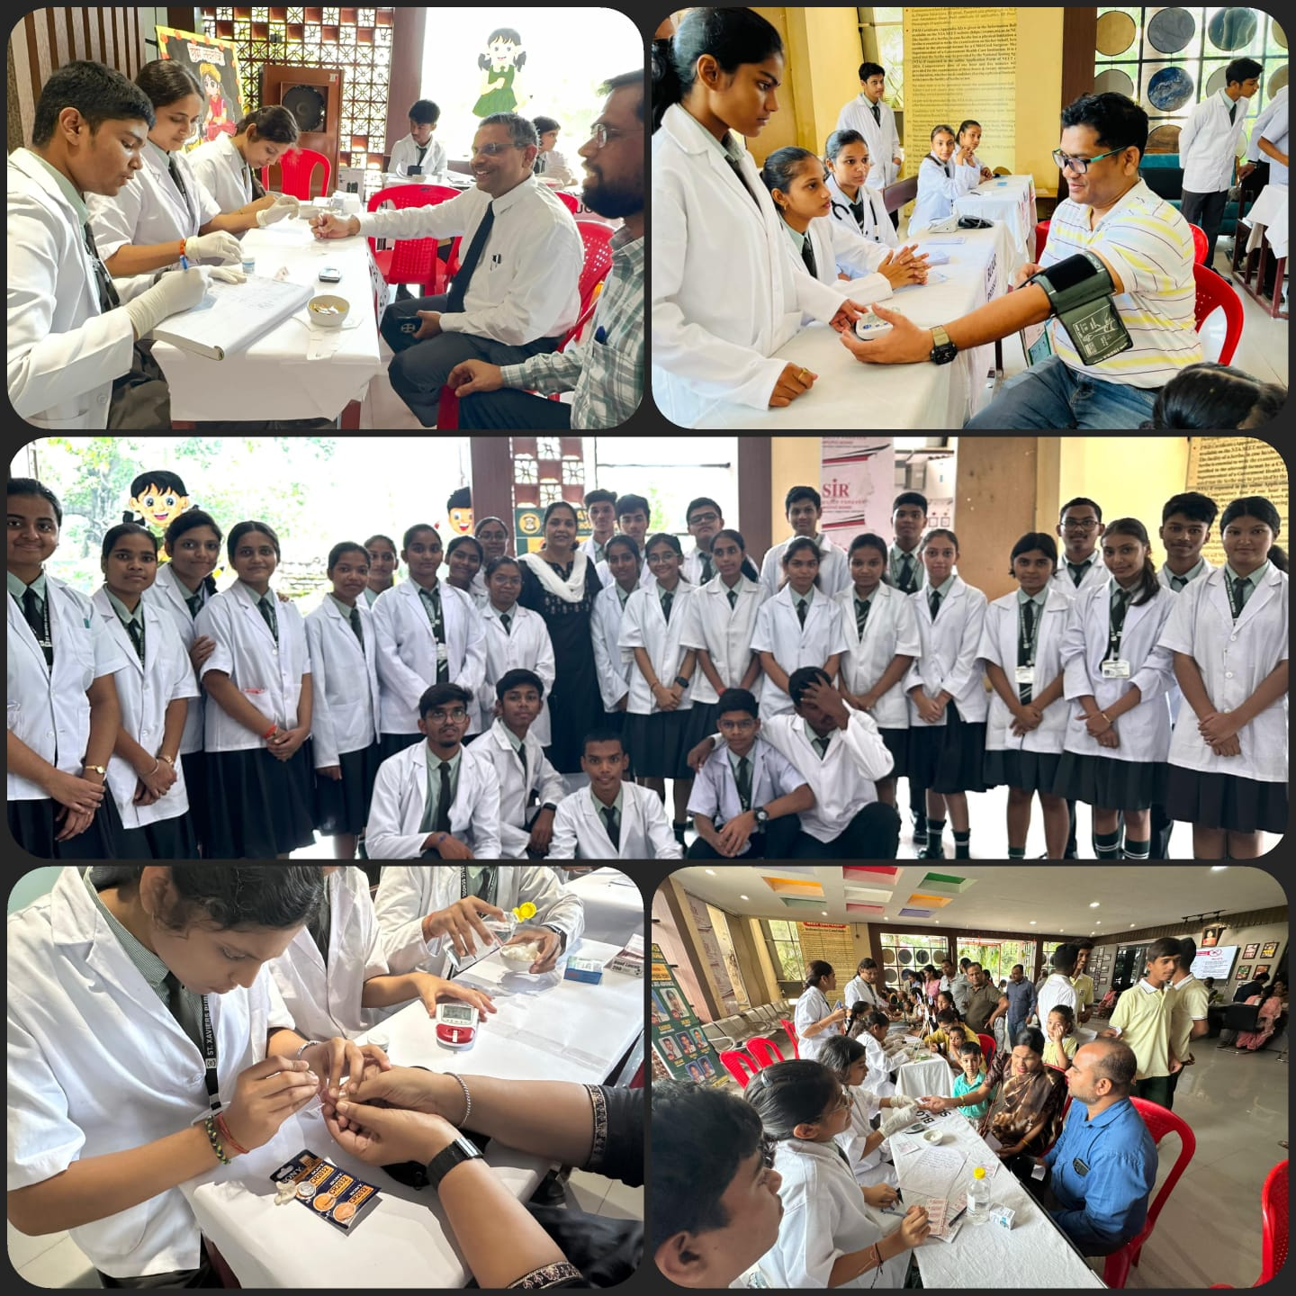
Medical camp

Slide 35
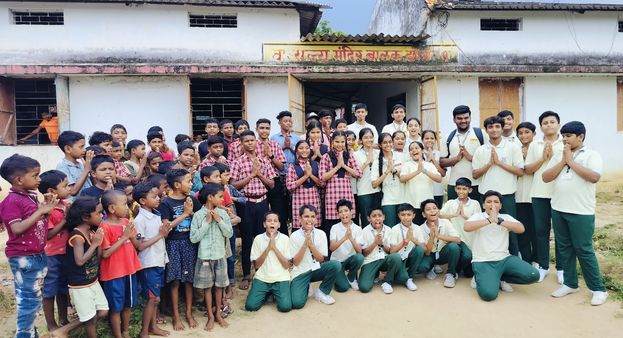
Visit to DEOPrAHARI

Slide 36
ECO FRIENDLY
projects

Slide 37
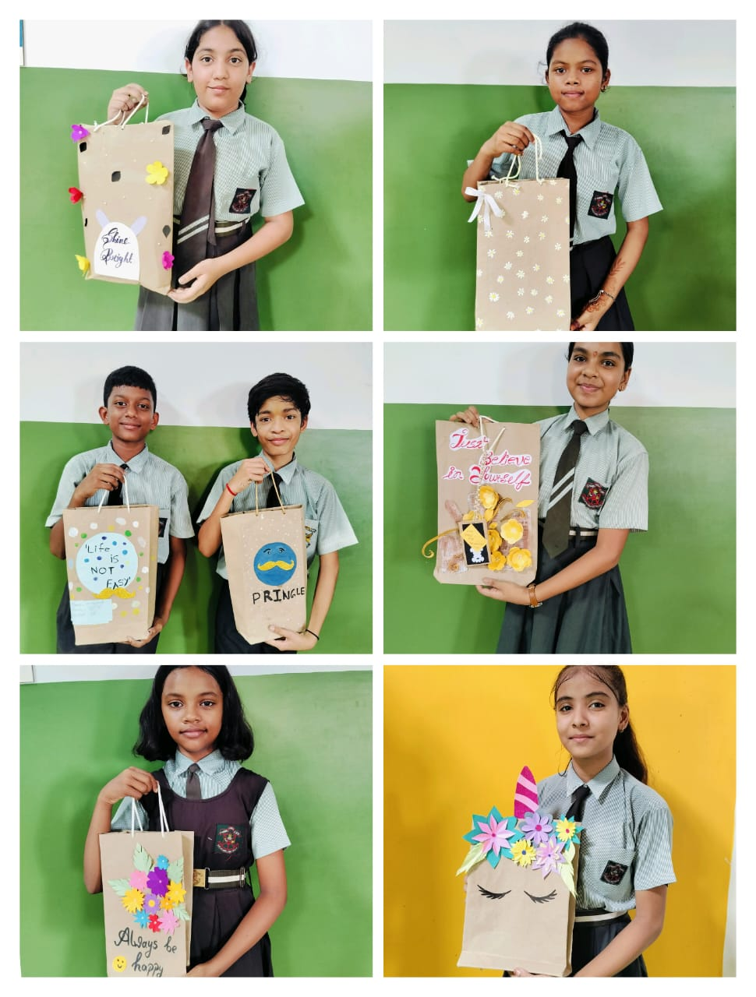
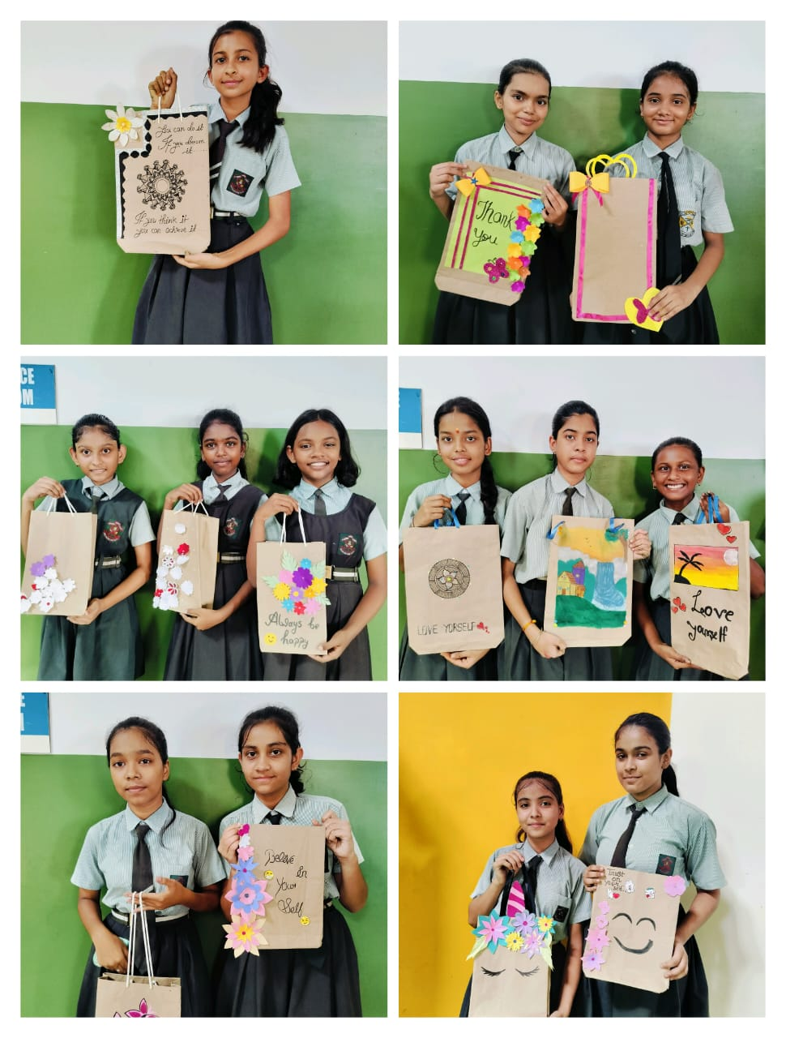
WORLD PAPER BAG DAY 12.07.2024

Slide 38
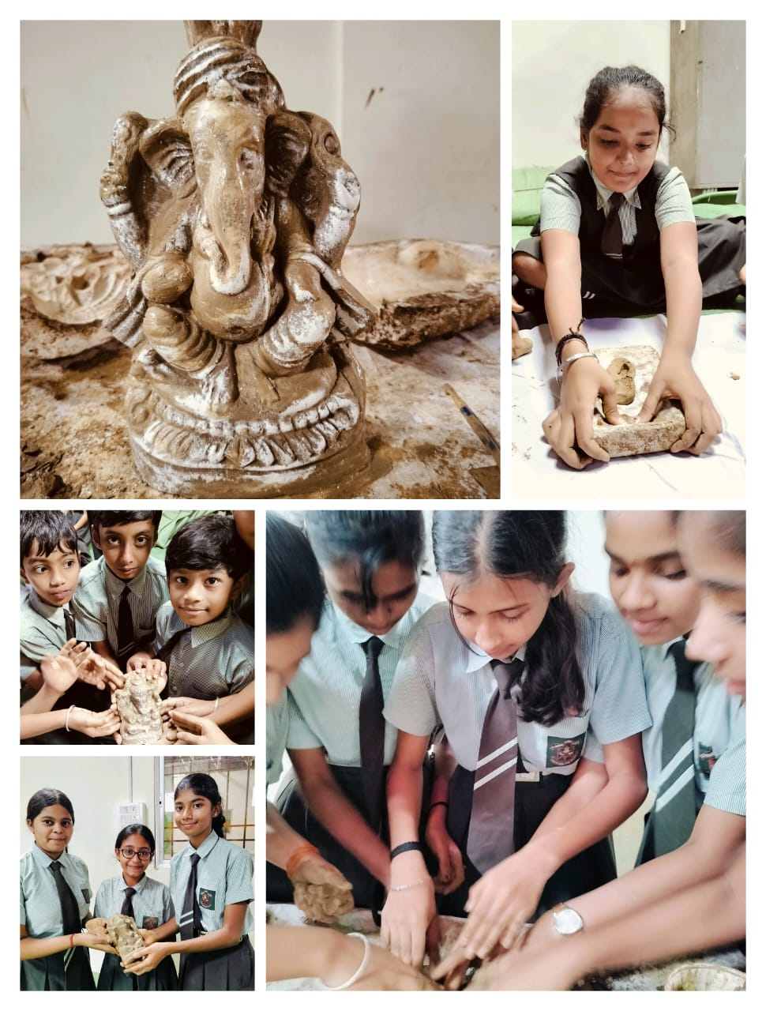
Ganesha making
EXHIBITION DATE- 28.05.2024

Slide 39
CELEBRATION of
NATTIONALISM

Slide 40
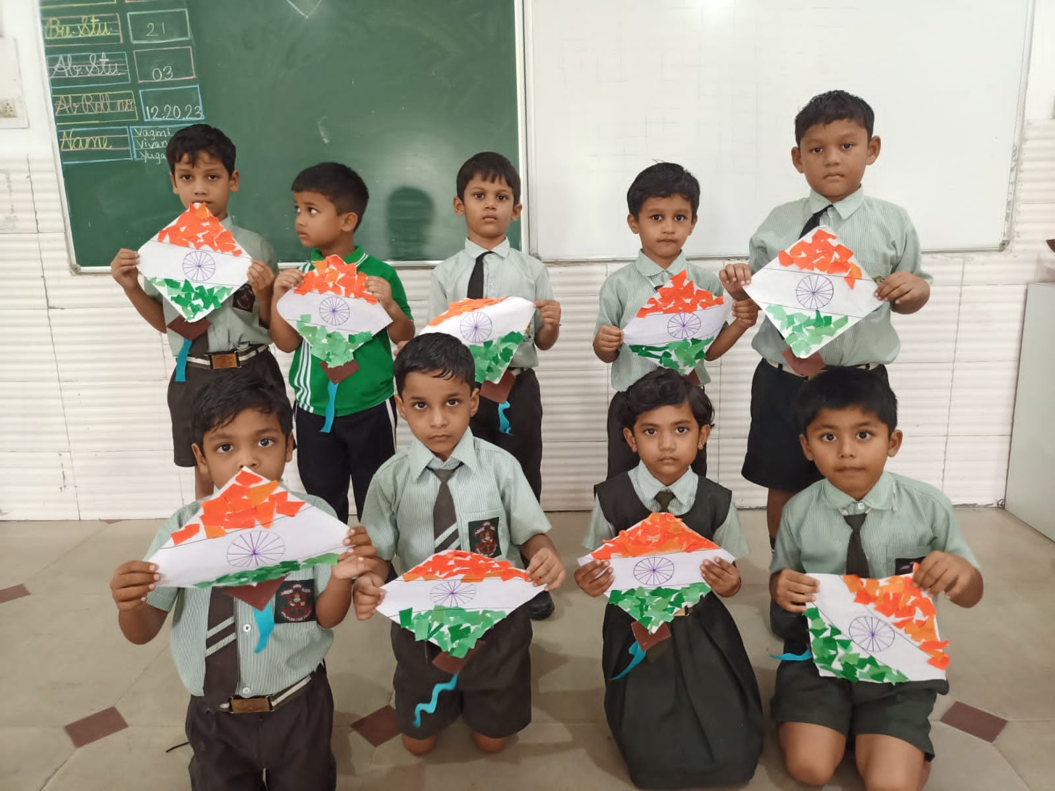
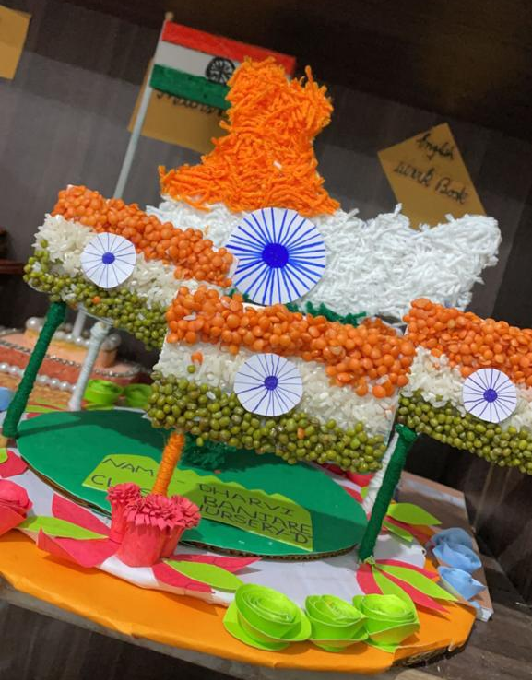
FLAG MAKING Activity

Slide 41
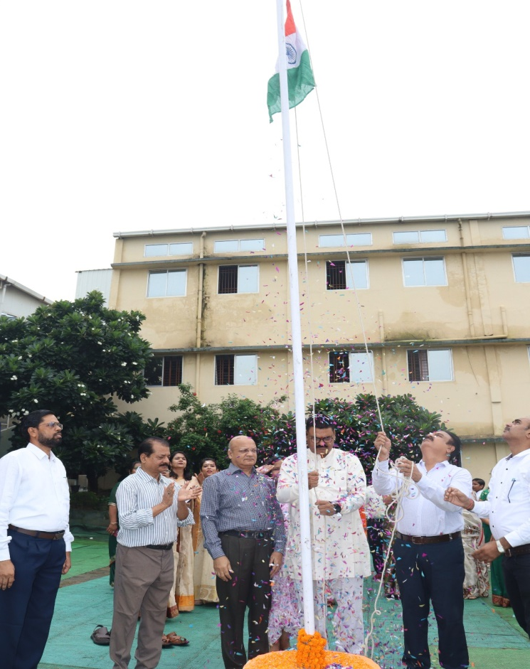
Independence day
15.08.2024

Slide 42
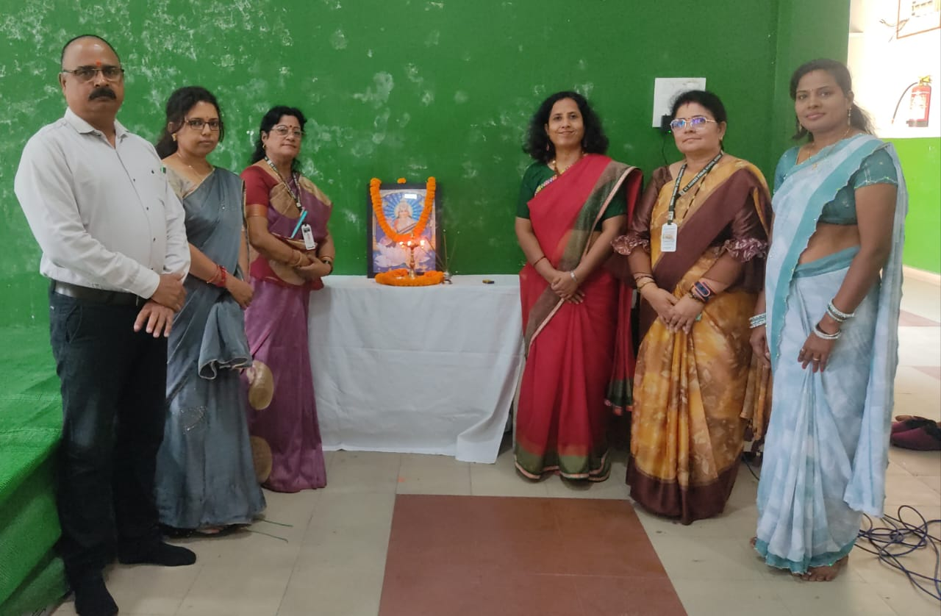
Hindi diwas 14.09.2024

Slide 43
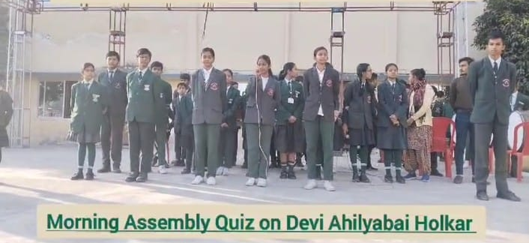
Special tribute to ahilyabai holkar

Slide 44
SEVERAL CLUBS

Slide 45
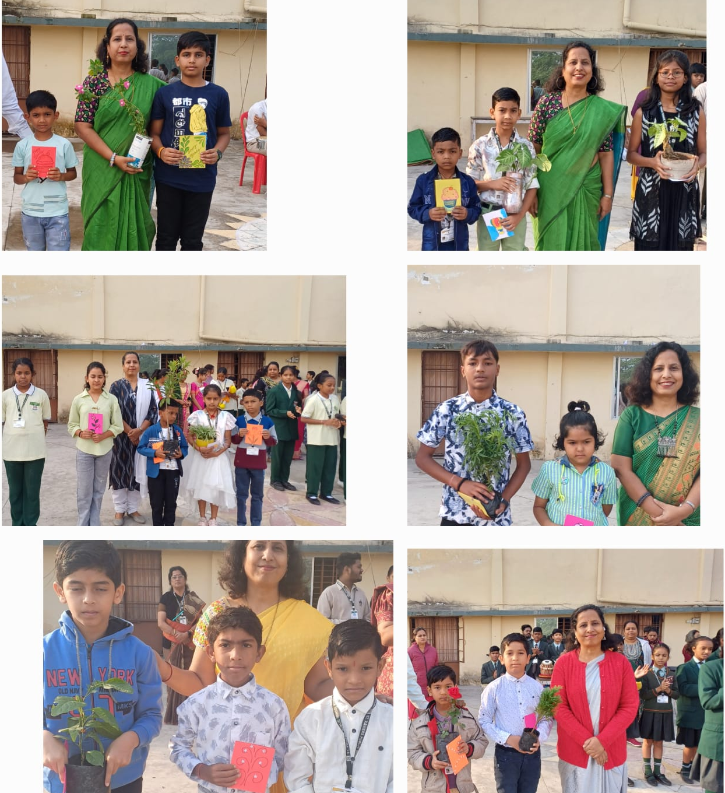
Eco club

Slide 46
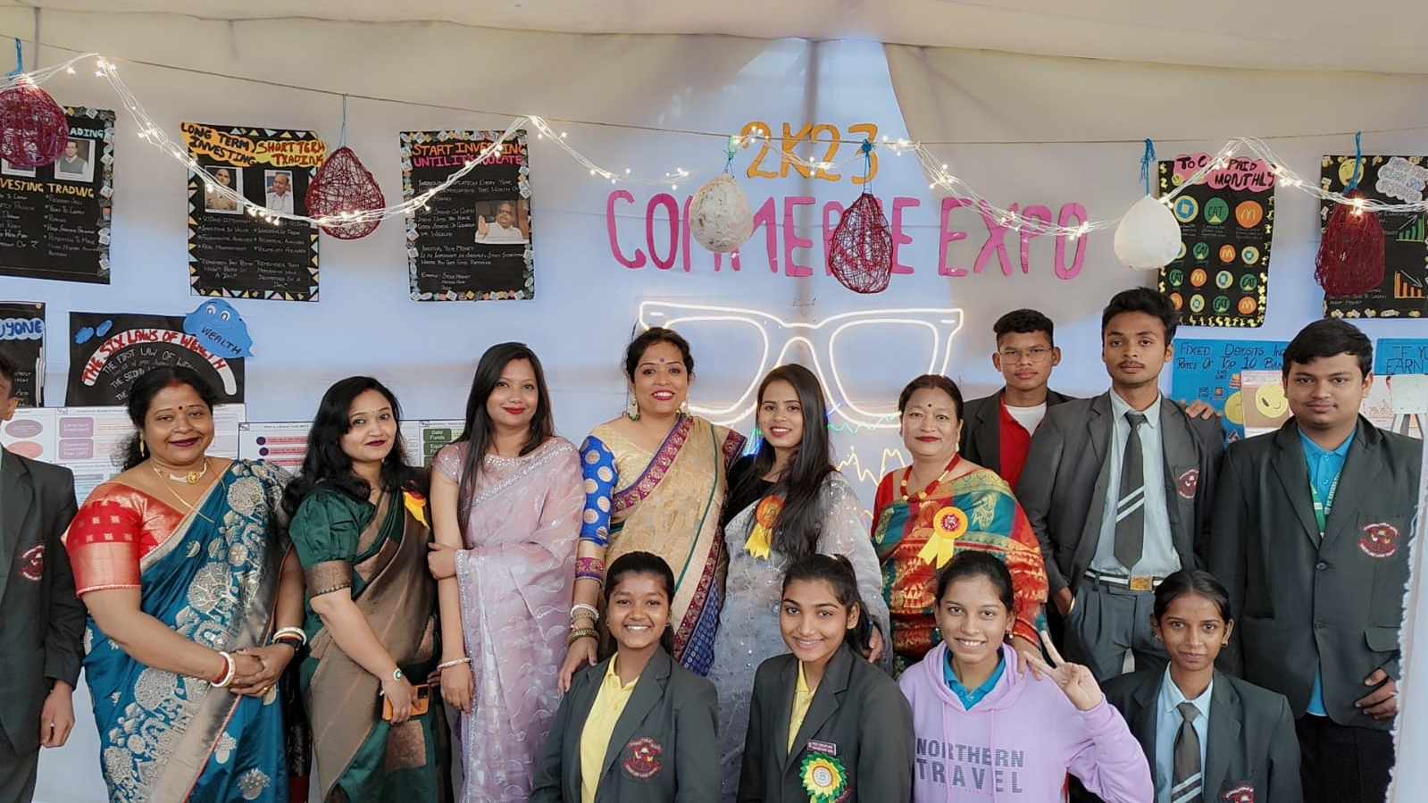
Commerce club

Slide 47
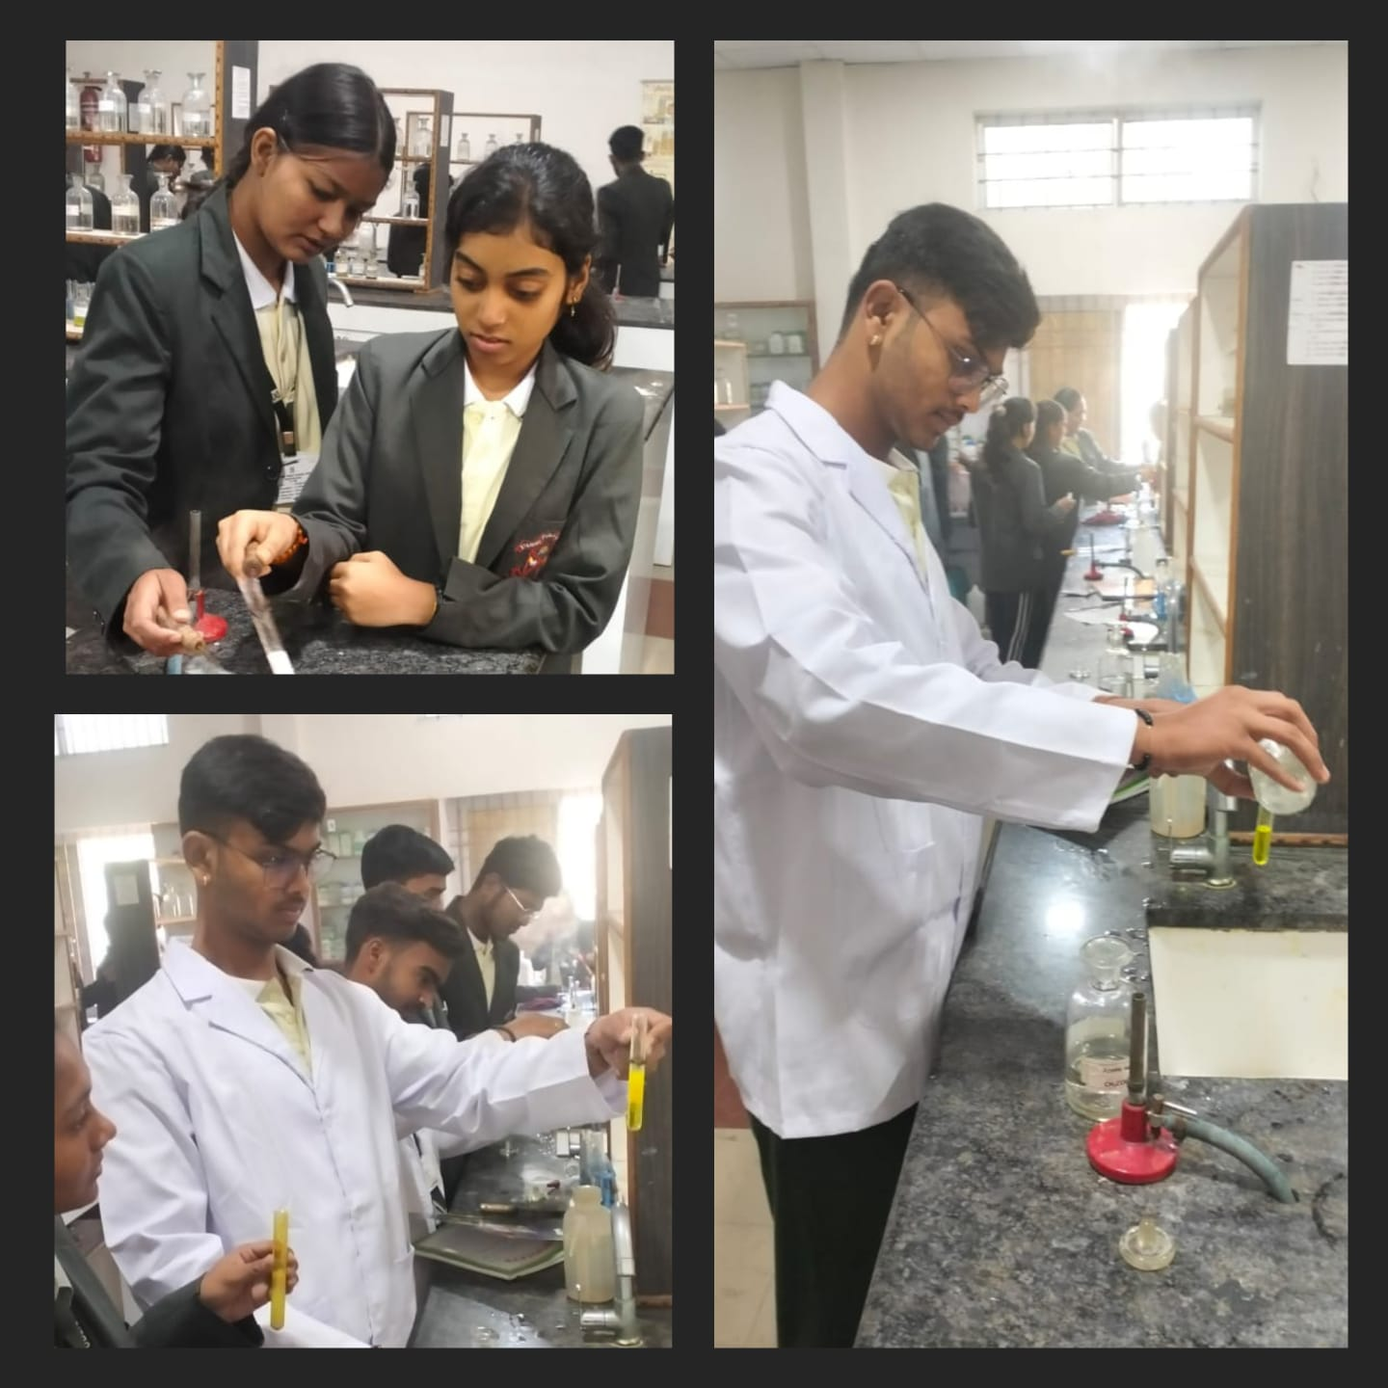
Science club

Slide 48
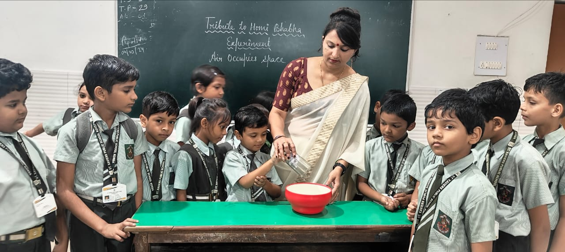
Tribute to homi bhabha 26.10.2024

Slide 49
DAY CELEBRATIONS

Slide 50
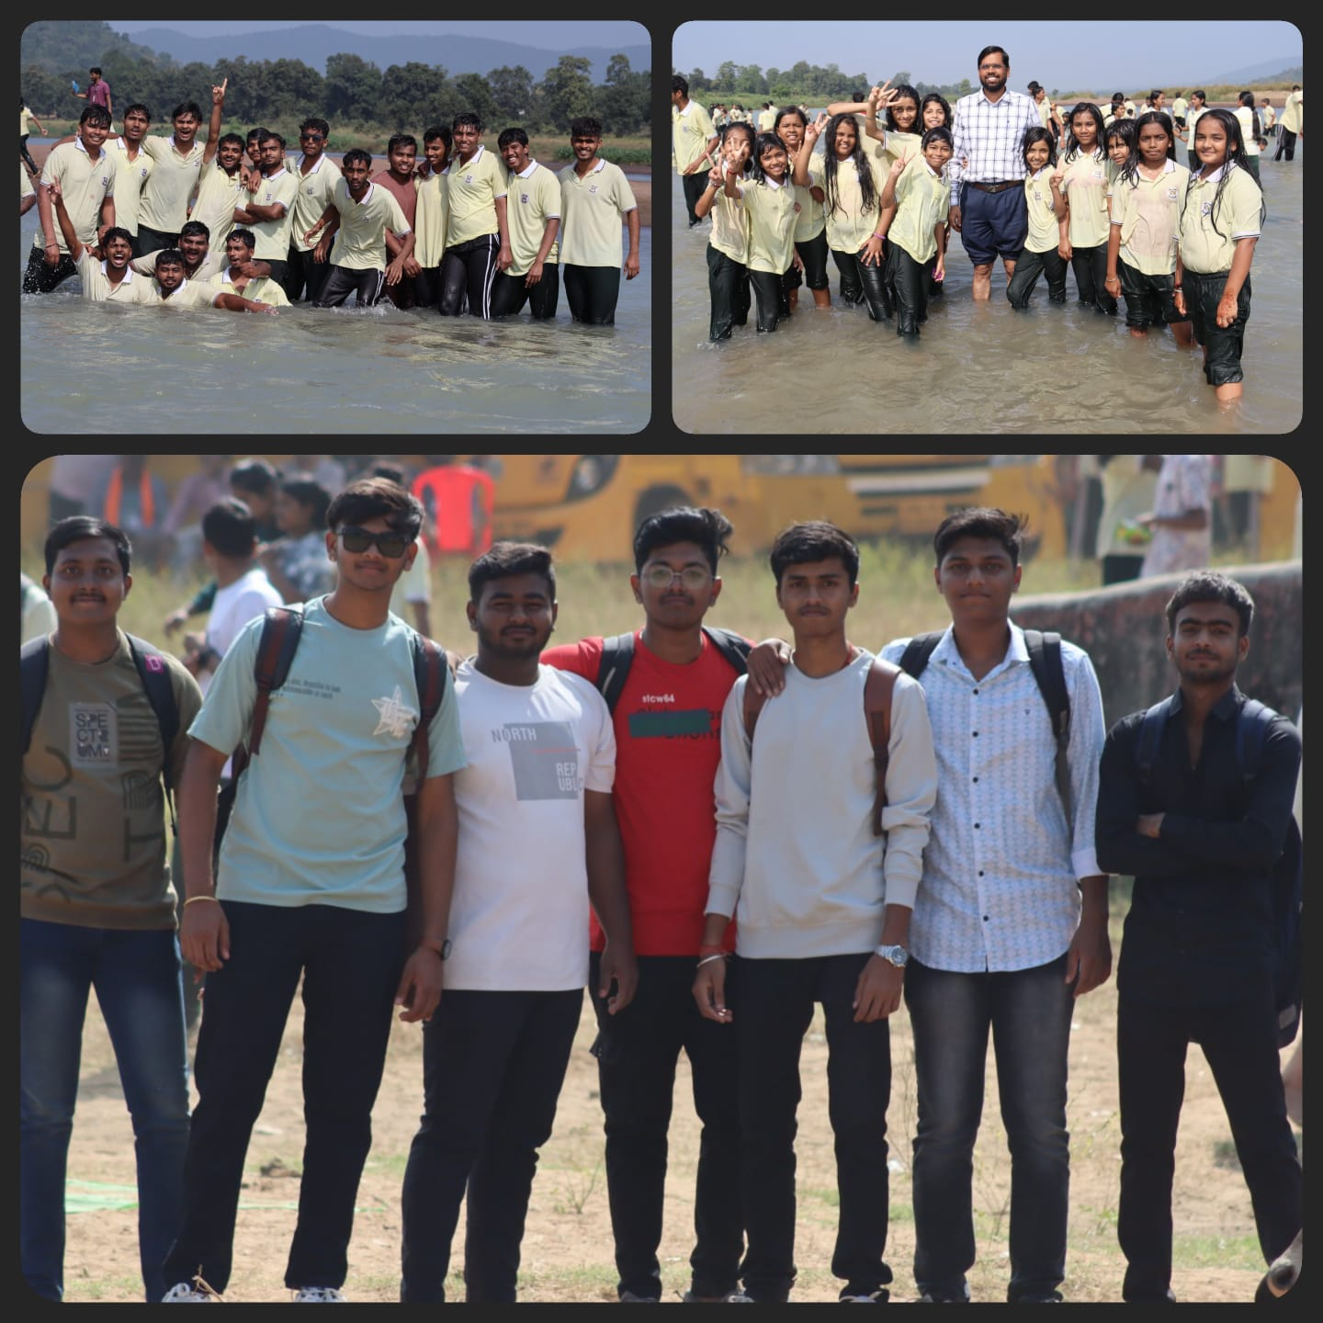
Children’s day celebration 14.11.2024

Slide 51
Excursion tour

Slide 52
